Slide 1
Mr. Right or Mr. Best: The Role of Information Under Preference Mismatch in Online Dating
Hongchuan Shen, Chu (Ivy) Dang, Xiaoquan (Michael) Zhang

Slide 2
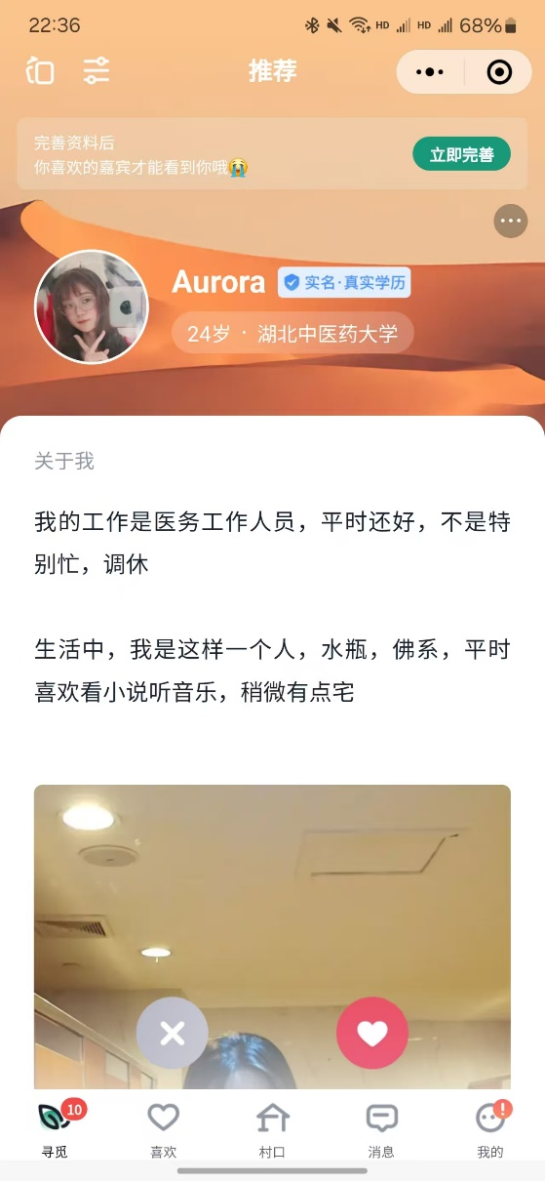
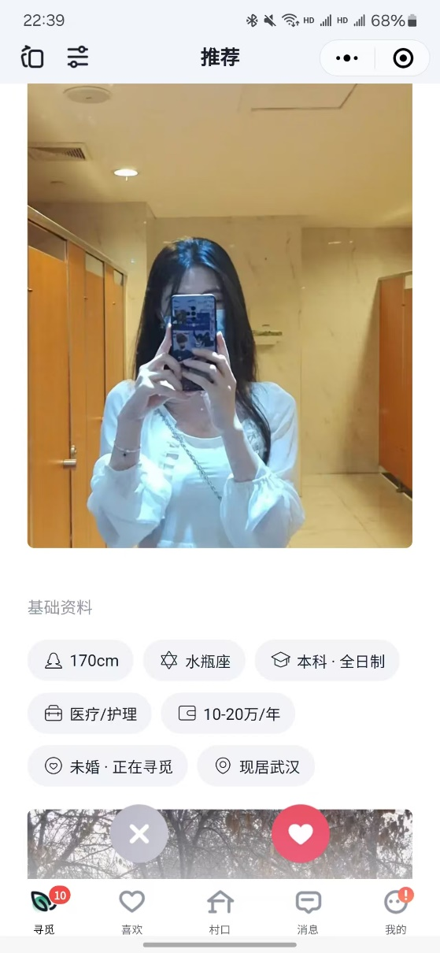
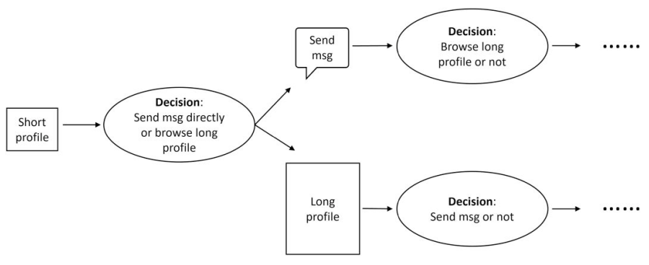
Introduction
Online Dating Platform:
Short Profile: partial information
Long Profile: complete information
Propose a match
Reply
Focal User
Candidate User

Slide 3
Introduction
Success of Online Dating Platform:
Depend on the role of information
OkCupid: allow users to check more detailed information before making a match proposal
Tinder: allow users to view only limited profile
Income: from charging for messages
Question: more information is better? Or Less is more?
Research Gap: little is known about the preferences of players from different sides and how they intertwine with information
Match Outcome:
Success: focal user proposes a match + candidate user replies
Preference mismatch: “you love her who doesn’t love you”
RQ: how matching outcomes are influenced by the amount of information obtained by the users?

Slide 4

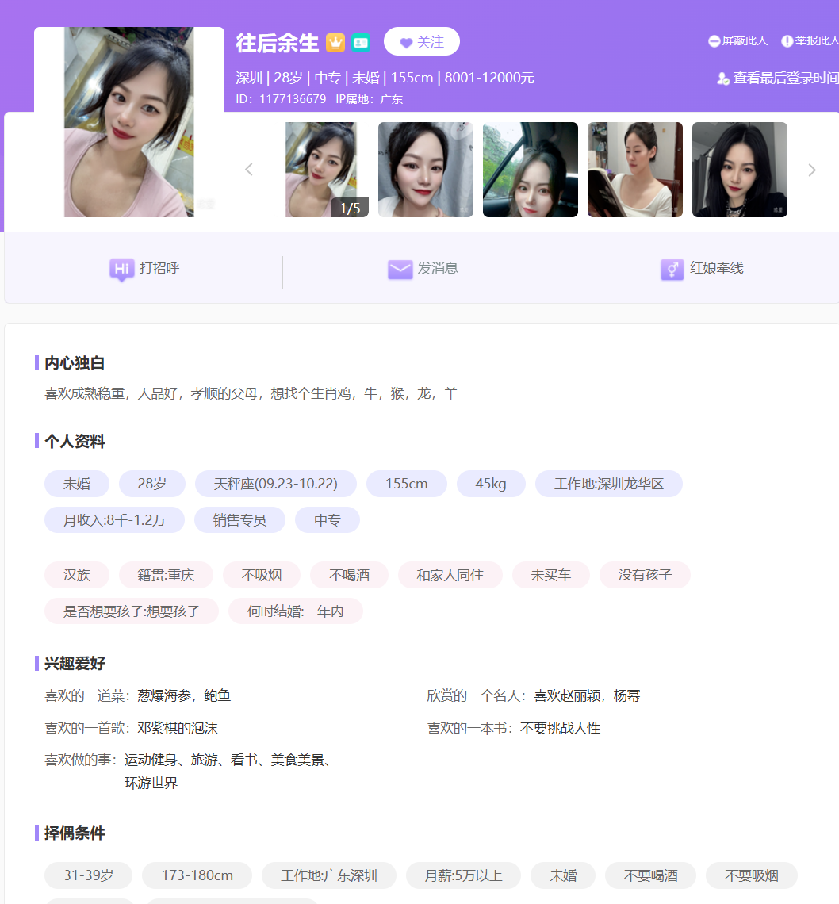
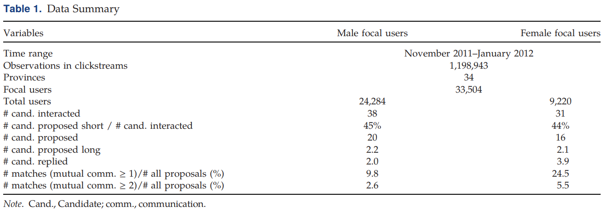
Methodology
Data Collection
An online dating site in China (maybe Zhenai.com)
Proprietory data; between 2011/11 and 2012/01
1,198,943 clicks from 33,504 focal users
E.g.
An average male user interact with 38 female candidates (browse, propose, message)
45% of them are proposed to based on their short profiles
Notes:
female users on a popular dating app are more selective and get more matches than men.

Slide 5
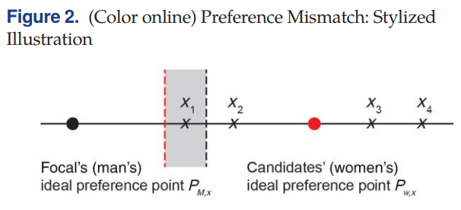
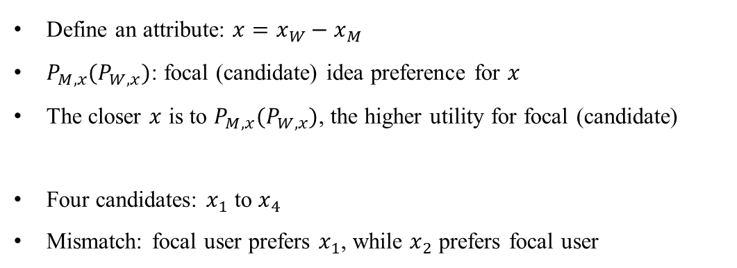
Evidence of Preference Mismatch
Example of Mismatch
Bob: 170cm Alice: 160cm
Bob favors 10cm shorter
Alice favors 20cm taller
Bob : 170cm -> 175cm
Mismatched preference: Alice likes Bob more, but Bob likes Alice less
Define an attribute: $x=x_{W}−x_{M}$
$P_{M,x}(P_{W,x})$: focal (candidate) idea preference for $x$
The closer $x$ is to $P_{M,x}(P_{W,x})$, the higher utility for focal (candidate)
Four candidates: $x_{1}$ to $x_{4}$
Mismatch: focal user prefers $x_{1}$, while $x_{2}$ prefers focal user
“Mr. / Ms. Right”

Slide 6
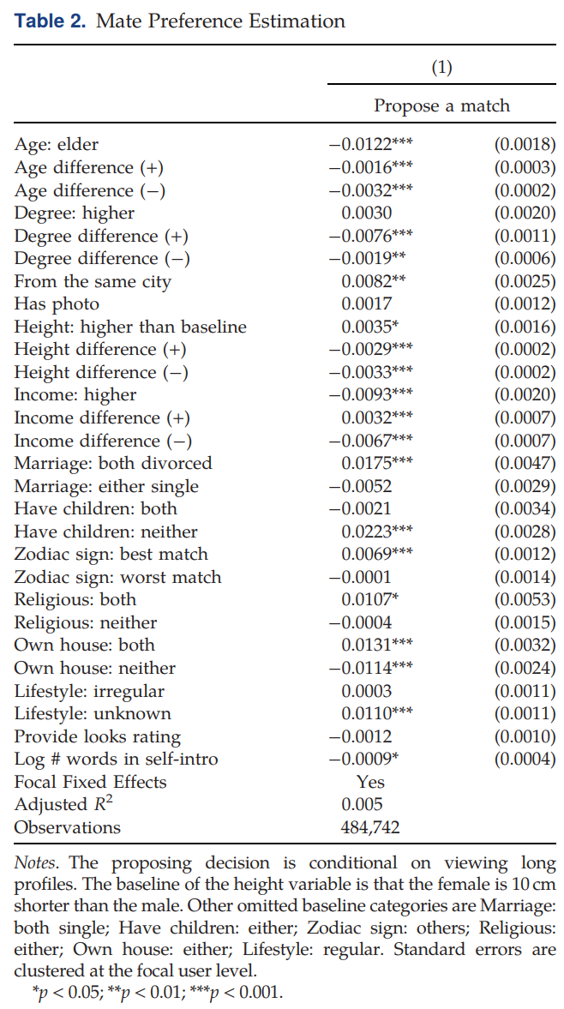
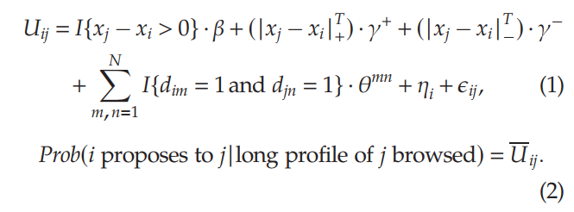
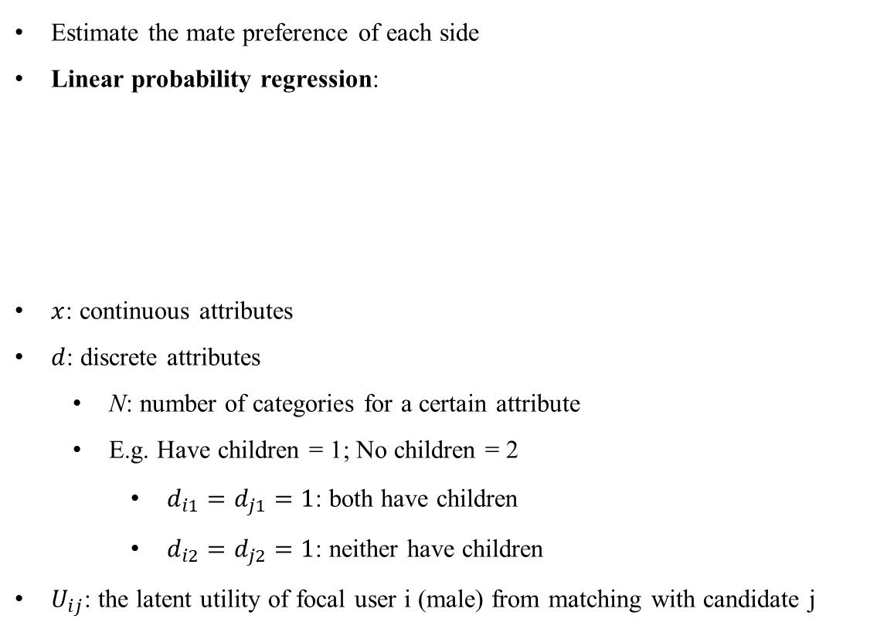
Evidence of Preference Mismatch
Attractiveness Score
Estimate the mate preference of each side
Linear probability regression:
$x$: continuous attributes
$d$: discrete attributes
N: number of categories for a certain attribute
E.g. Have children = 1; No children = 2
$d_{i1}=d_{j1}=1$: both have children
$d_{i2}=d_{j2}=1$: neither have children
$U_{ij}$: the latent utility of focal user i (male) from matching with candidate j

Slide 7

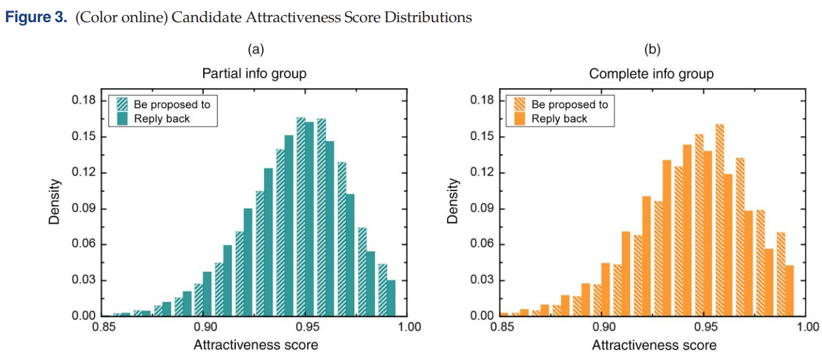
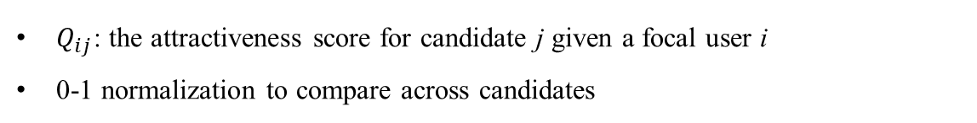
Evidence of Preference Mismatch
Candidate Attractiveness Score
$Q_{ij}$: the attractiveness score for candidate j given a focal user i
0-1 normalization to compare across candidates
Aligned preference: higher attractiveness score with more likely reply
Focal users propose based on short & long profile:

Slide 8
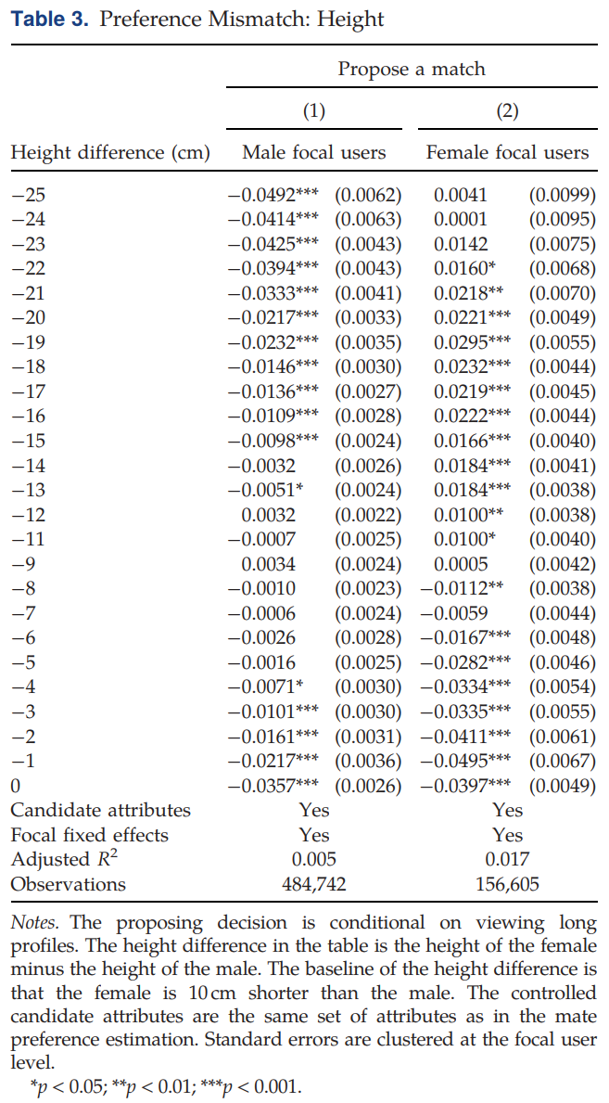
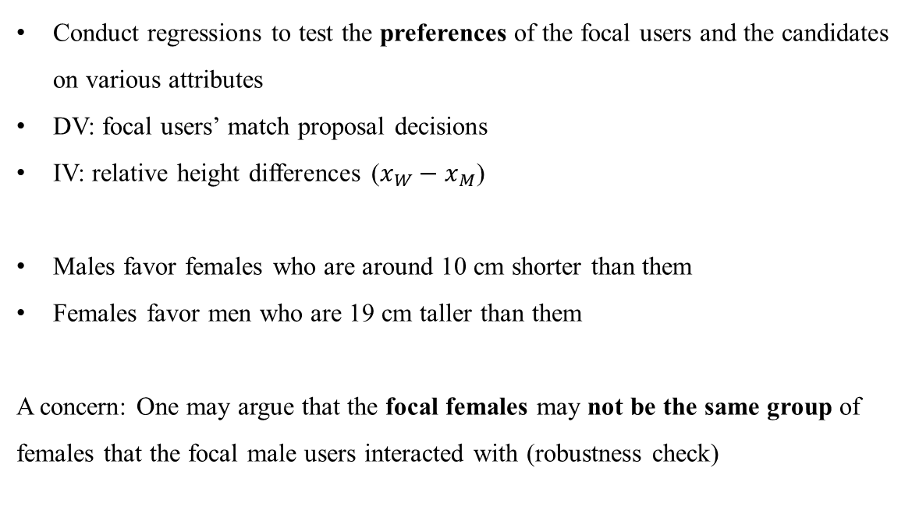
Evidence of Preference Mismatch
Attribute-Level Preference
Conduct regressions to test the preferences of the focal users and the candidates on various attributes
DV: focal users’ match proposal decisions
IV: relative height differences ($x_{W}−x_{M}$)
Males favor females who are around 10 cm shorter than them
Females favor men who are 19 cm taller than them
A concern: One may argue that the focal females may not be the same group of females that the focal male users interacted with (robustness check)

Slide 9
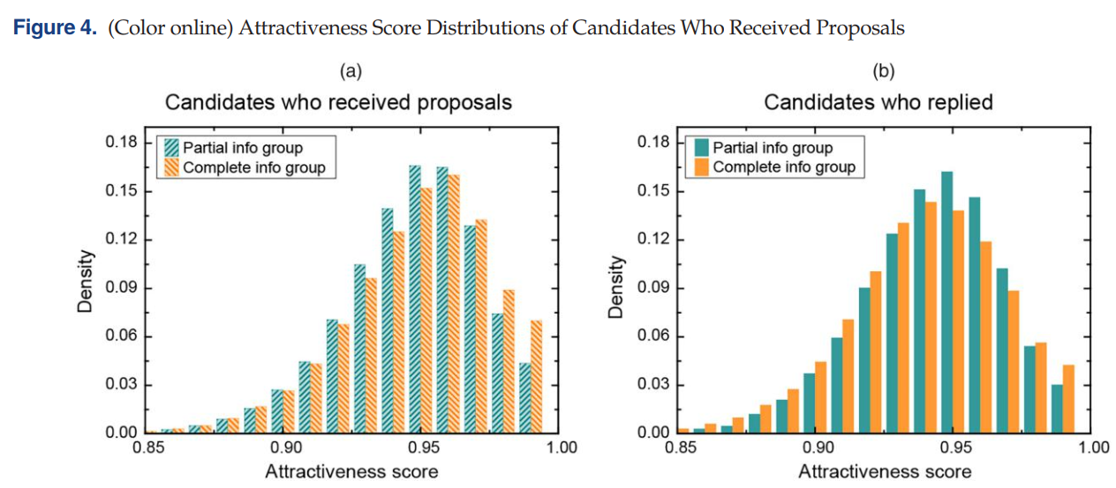
Information Role Under Preference Mismatch
Q: Given the preference mismatch, should the online dating platform provide more or less information to users?
Intuition: with more information about the candidates, focal user will select candidates who are closer to his ideal preference (i.e. Ms. Best), and candidates who are in the Ms. Right region will be ruled out
Suppose: the degree of preference mismatch in the complete info group is stronger than that in the partial info group
“Less information is more” effect:
Propose based on information contained in the short profile results in a better matching outcome

Slide 10
Information Role Under Preference Mismatch
Q: Given the preference mismatch, should the online dating platform provide more or less information to users?
Complete info group has a higher attractiveness score compared with the partial info group
Partial info group candidates are actually more attractive to the focal users than those from the complete info group
The degree of preference mismatch in the complete info group is much stronger than that between the focal users and the candidates in the partial info group

Slide 11
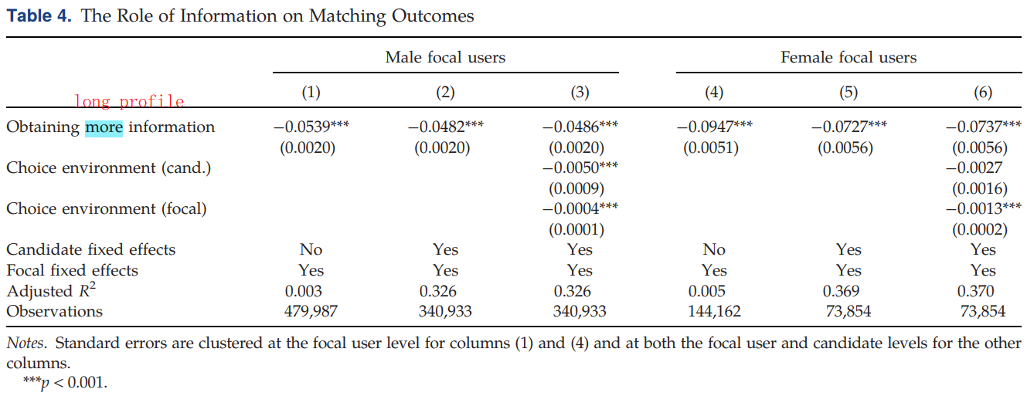
Information Role Under Preference Mismatch
Q: Given the preference mismatch, should the online dating platform provide more or less information to users?
Conditional on the focal user proposing a match:
DV: matching outcome
DV = 1 if the frequency of message exchange is over a certain number (e.g. 1, 2, 3, 4)
IV: whether a focal user obtain more information about a candidate
Control: dynamic choice environment: count the number of ongoing communications a user has at time t when she or he is making messaging decisions

Slide 12
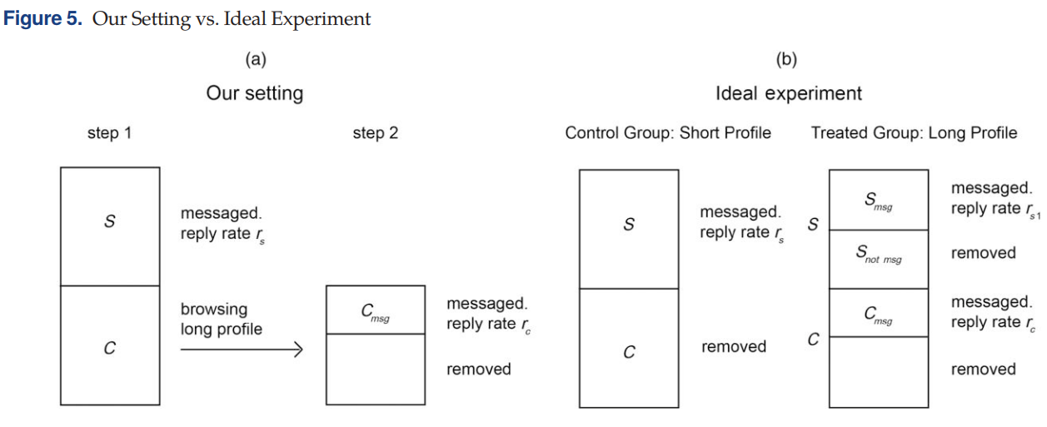
Information Role Under Preference Mismatch
An Ideal Experiment
A concern: possible selection issue
Short versus long profiles are not exogenously given to the users, results may suffer from the issue of self-selection
Also conduct online experiments and simulations to exogenously provide different amounts of information to the focal users
The effect still holds

Slide 13
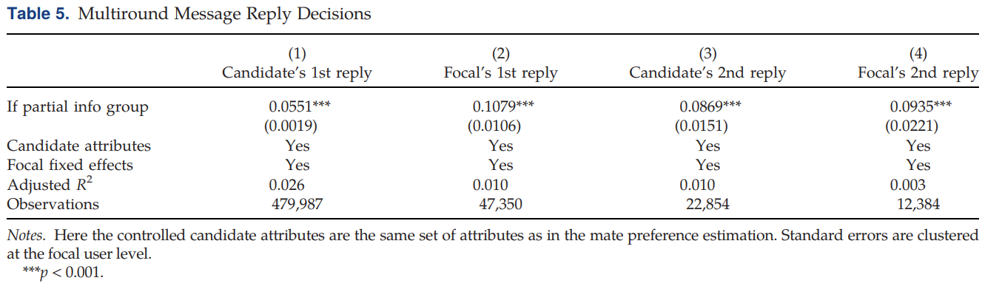
Information Role Under Preference Mismatch
The lasting effect of preference mismatch
Conditional on a focal user sending the first contact message:
Preference mismatch not only affects the candidate’s first reply decision (column (1)) and the focal user’s first reply decision (column (2)), but also affects their subsequent reply decisions

Slide 14
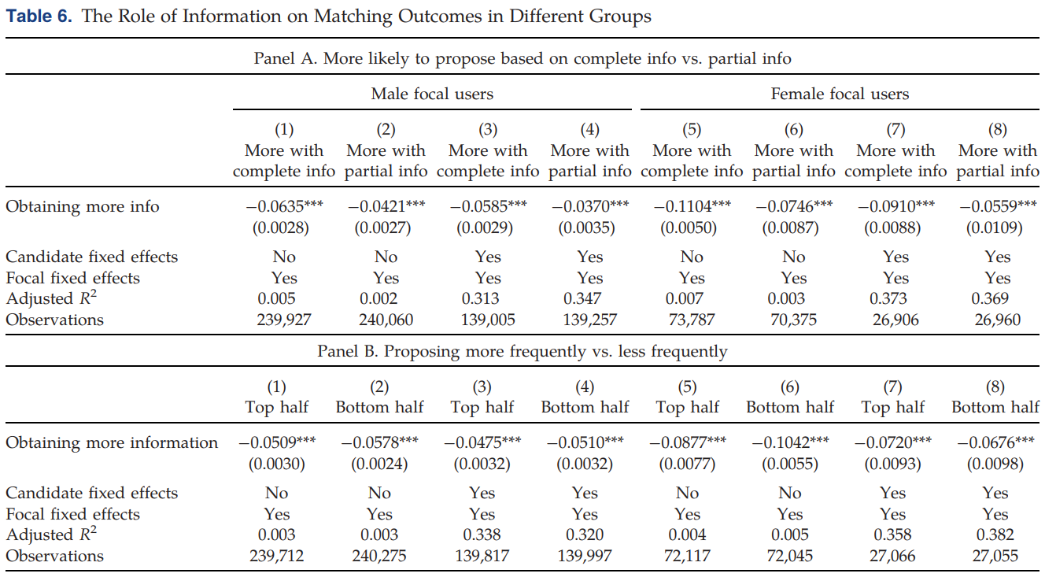
Discussion
Heterogeneous Goals
A concern: different focal users may have different goals (self-selection)
E.g. those who are not looking for marriage may be more likely to send a message without reading long profiles
Solution 1. control individual fixed effect
Solution 2. subsample regression
Panel A: group by proposing method
More with complete info: propose based on long profile more than 50% time
More with partial info: otherwise
Panel B: group by proposal frequency
Top half: proposal frequency above the median
Bottom half: otherwise

Slide 15
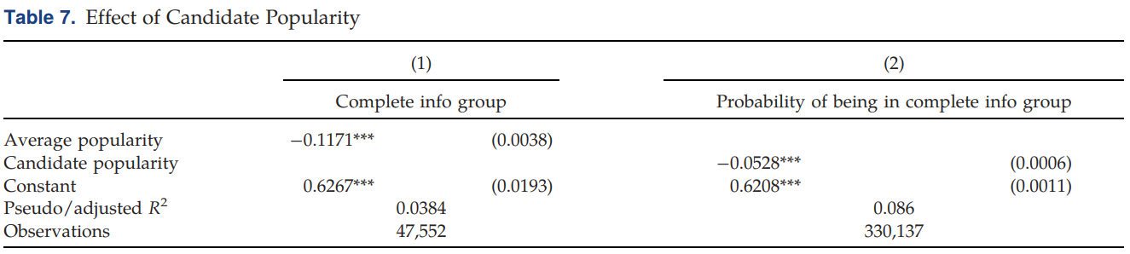
Discussion
Candidate Popularity and Pickness
Another explanation for the “less is more”: candidates whose long profiles are searched also turn out to be the ones who are more popular or who have a higher reservation value (i.e., they are pickier)
More popular and pickier candidates are less likely to reply
Solution 1. control candidate fixed effect
Solution 2. another regression
IV: candidate popularity (measured by the total number of focal users proposing)
DV: in the complete / partial group (1 / 0)

Slide 16
Discussion
Manipulation of Short Profiles
A manipulation concern: candidates who are eager to find a match may polish their short profiles to make them very attractive
They are also more likely to reply given their desire to be matched sooner rather than later
Solution: no much room to manipulate or polish a short profile (candidate fixed effect)
Inferring Long Profiles from Short Profiles
A concern: some information in the long profiles can be inferred from the short profiles
In this case: the difference in the amount of information uncovered from the two profiles will be smaller
The current result of the role of information under preference mismatch is underestimated
“less information is more” effect should be more pronounced

Slide 17
Discussion
Boundary Condition
Centralized matching platform: not applicable
Uber, Didi, ...
more applicable to decentralized matching platforms, like Tinder, Upwork, and Airbnb, where user preferences play a key role in the search process
Low mismatcg cost: not applicable
with lower mismatch cost, focal users will propose more
Imbalanced bargaining power: not applicable
the final matching outcome will depend more on the preference of the side with the stronger bargaining power
Extremely high communication cost: not applicable
dominate the preference mismatch effect
E.g. on Airbnb, communication cost is relatively high (deadlines are imminent and guests and hosts may not always be available online). Guests may need more upfront information to reduce communication time

